Slide 1

TRAIN NEO BIT
Cognichip Hackathon
EcoTraining: An Energy-Efficient Hardware Design for Gradient Compression in LLM Training
By Feiyu Jia, Heng Pu, Lixuan Xu, Yuhan Jiang
https://github.com/fjia-xu/Cognichip-Hackathon-by-Train-Neo-Bit.git

Slide 2
CONTENTS
01
Problem Statement & Motivation
02
RTL Architecture
03
Design Methodology
04
Simulation Results
05
Challenges & Lessons Learned
06
Future Work

Slide 3
01
Problem Statement & Motivation

Slide 4
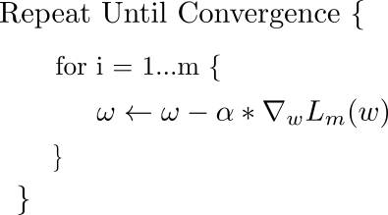
Problem Statement: “Memory Wall” in AI Training
GPU Training Steps
Forward Pass
Backward Pass
Memory wall: HBM/cache bandwidth; activation write traffic
Memory wall: heavy gradient/activation traffic + write-backs
01
03
02
04
Loss Computation
Optimizer Step
⭐ Memory wall: write-intensive state updates + cache/DRAM pressure

Slide 5

Problem Statement: “Memory Wall” in Gradient Update
The memory wall becomes acute at the gradient update (optimizer) stage because the update is dominated by streaming reads/writes of large tensors: for each parameter, the optimizer typically reads the weight and its gradient, reads and updates optimizer state (often larger than the model itself), and writes back the updated state and weight.

Slide 6
02
RTL Architecture

Slide 7
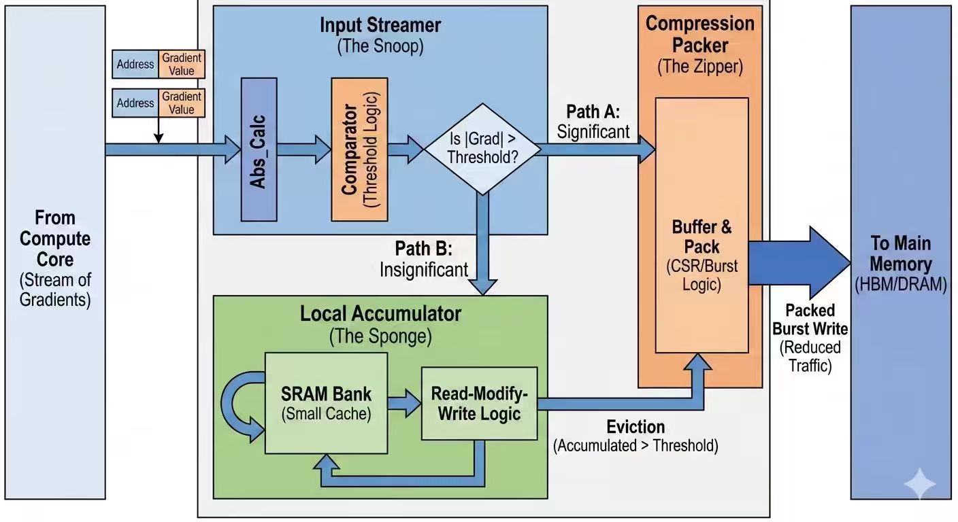
Gradient Compressor Architecture
This diagram illustrates our group’s design of a gradient compressor for LLM acceleration. The architecture is organized into three main stages: the Streamer, the L1 Accumulator, and the L2 Writeback Buffer. We assume a single-cycle processing model for simplicity.
This design reduces DRAM traffic by separating large and small gradient handling:
Large gradients bypass accumulation and are written back directly.
Small gradients are accumulated locally in L1 to compress updates before writing back.
L2 aggregates writeback traffic to enable efficient burst transmission to DRAM.
(In the future we can try our best to make these stages pipelined but this time we assume it was the single-cycle assumption)

Slide 8
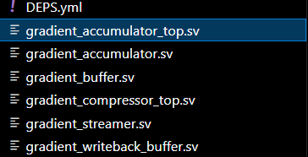
Gradient Compressor Architecture: RTL Design Logic hierarchy
The gradient_accumulator.sv is used for set up interface connection between the whole ALU part and the L2 buffer
The gradient_accumulator_top.sv and streamer dive into the alu logic design which is used for the logic detection and doing data distribution, Writeback Decision and L1 Update Logic
The gradient_accumulator_buffer is used for the data storage and tag storage
The gradient_compressor_top is the main top which used to exposed the interface for the testbench to operate

Slide 9
Gradient Compressor Architecture: Streamer
Stage 1: Streamer
The first block, called the Streamer, receives gradient inputs from the testbench on every cycle. Its primary function is to perform threshold comparison and classify incoming gradients.
If the magnitude of the gradient exceeds the predefined threshold, it is considered a large update. In this case, the gradient bypasses the L1 Accumulator and is directly forwarded to the L2 buffer. These large updates are temporarily stored in L2 and later transmitted to DRAM in burst mode when the buffer becomes full.
If the gradient magnitude is below the threshold, it is considered a small update and is sent to the Accumulator stage for further processing.

Slide 10
Gradient Compressor Architecture: L1 Accumulator
Stage 2: L1 Accumulator (Set-Associative)
The Accumulator is designed to accumulate small gradients efficiently. It is implemented as a set-associative L1 structure.
When a small gradient arrives:
If the tag matches an existing entry (hit), the gradient is accumulated with the stored value.
If the accumulated value reaches or exceeds the threshold, it is immediately pushed to the L2 buffer.
If the accumulated value remains below the threshold, it stays in the L1 entry for further accumulation.
Data may also be written back to L2 under the following conditions:
Eviction: This occurs only when there is a tag miss and the corresponding set is full. A victim entry is selected and written back to L2.
Maximum Update Count: If an entry’s update counter reaches 255, a forced writeback is triggered to prevent indefinite accumulation.

Slide 11
Gradient Compressor Architecture: L2 Writeback Buffer
Stage 3: L2 Writeback Buffer
The L2 buffer stores all writeback data, including:
Large gradients bypassed from the Streamer
Accumulated gradients flushed from L1
Evicted entries
When the L2 buffer becomes full, it transmits its stored data to DRAM in burst mode. This burst-based transfer improves memory bandwidth efficiency and reduces frequent small writes to DRAM.

Slide 12
03
Design Methodology

Slide 13
Design Methodology
First Step--Problem Definition
The hardware design describes a Gradient Compressor and Accumulator, which is typically used in machine learning accelerators to reduce memory bandwidth by locally caching and accumulating weight gradients before writing them back to main memory (DRAM).
The system implements a hierarchical, two-level write-combining architecture (L1 cache and L2 FIFO) to decouple compute from memory latency.
Second Step--Design Structured Circuits

Slide 14
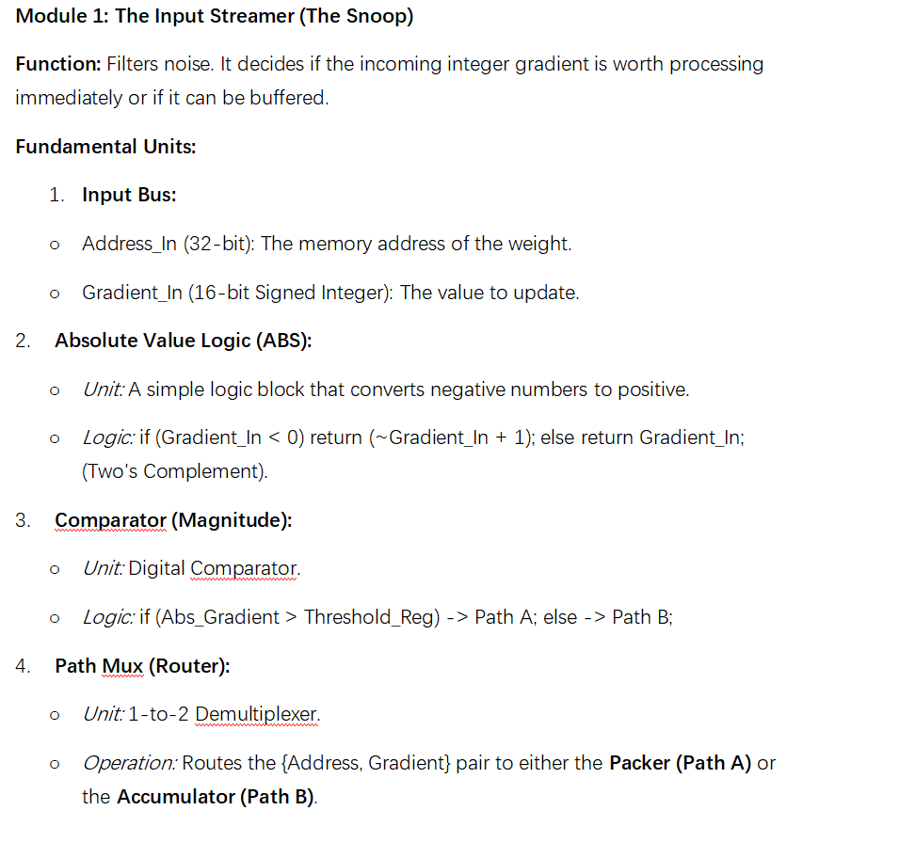
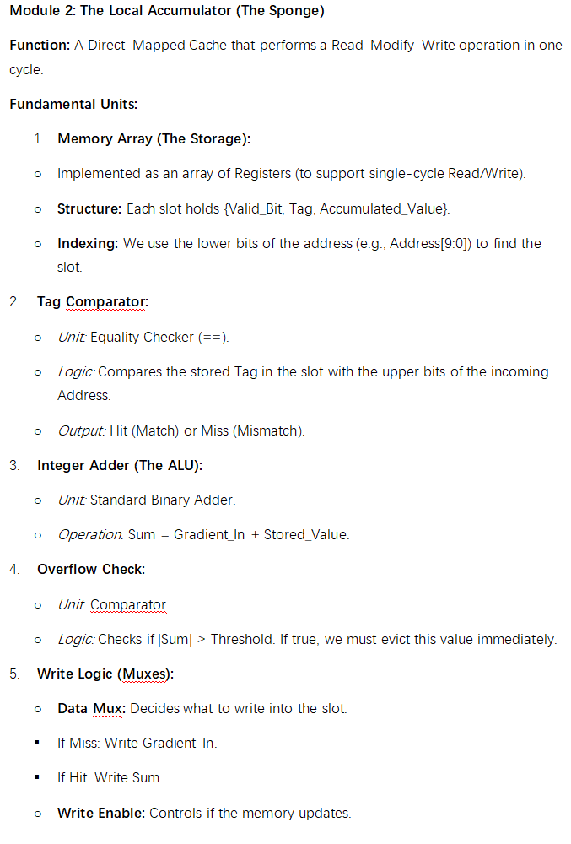
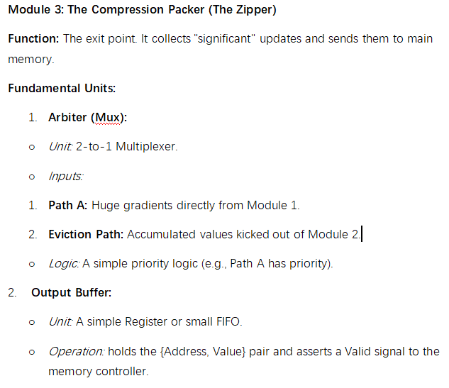
Design Methodology
Third Step--Generate Submodule Prompts & Summary
First generate the prompt of each submodule and let Cognichip platform generate the .sv file of each submodule. Then generate the top-level file and connect each sub-module.

Slide 15
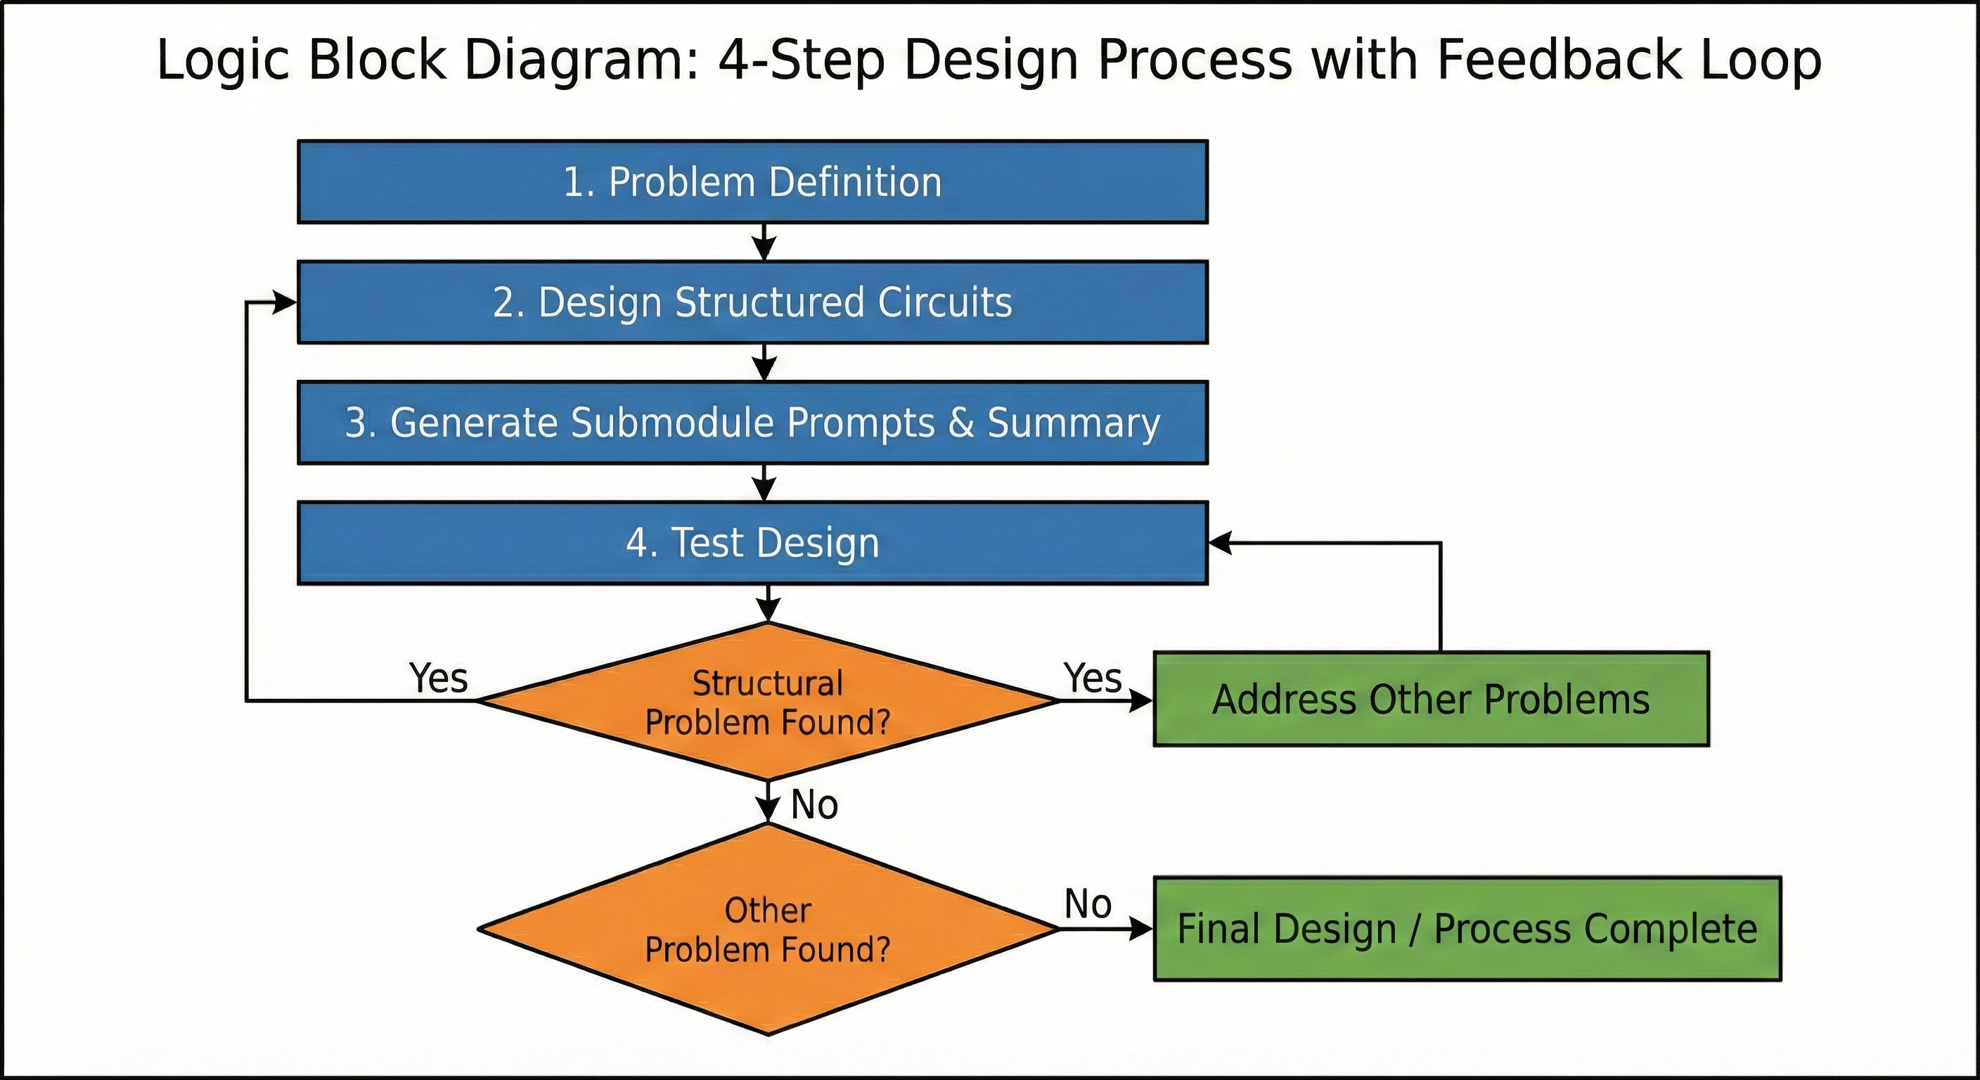
Design Methodology
Forth Step--Test & Problem Solving
When we run the simulation file and find the problem,
if it is found to be a structural problem, we will redesign the circuits, add or delect some submodules to meet our needs. Then repeat forth step to test the design.

Slide 16
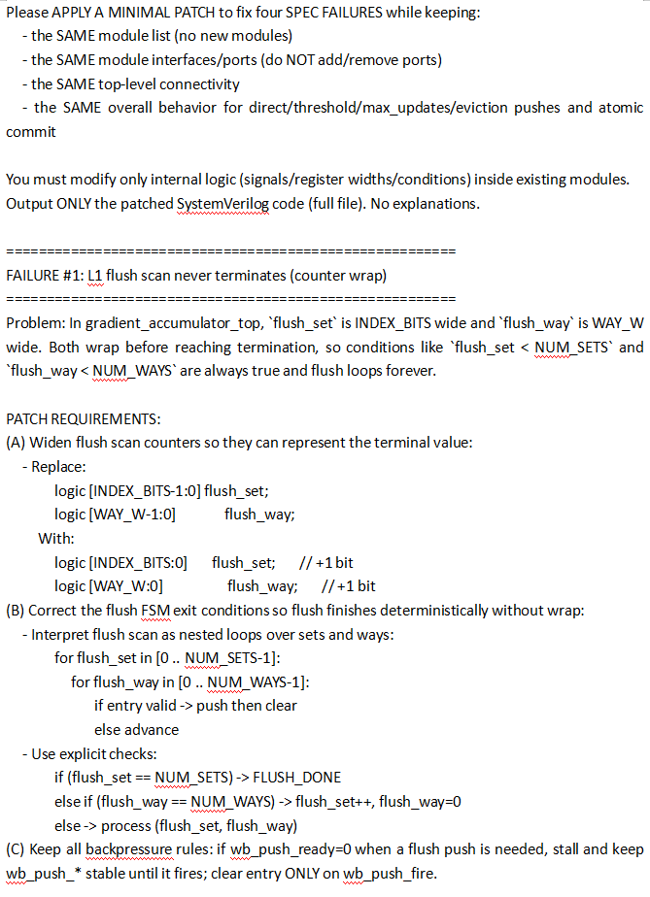
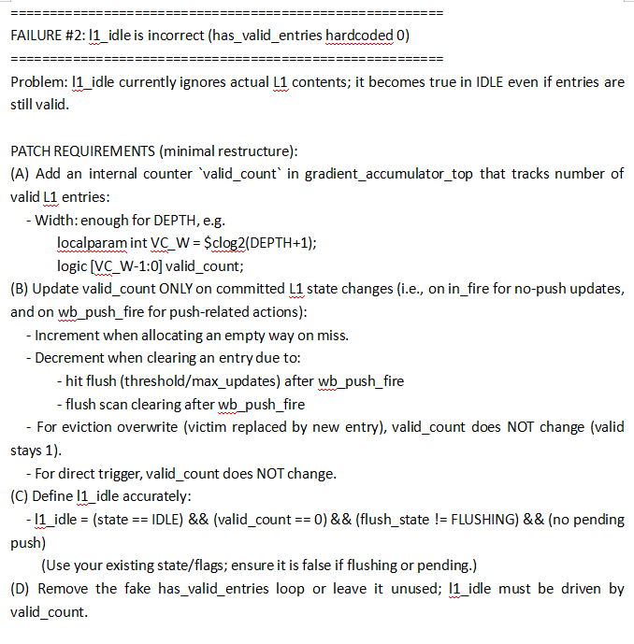
Design Methodology
Forth Step--Test & Problem Solving
If it's not a structural issue, we just need to patch the files that need modification.

Slide 17
04
Simulation Results

Slide 18
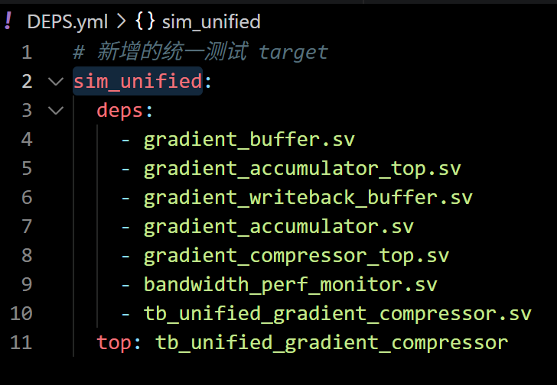
Simulation: Testbench Architecture & Connectivity
1. Architecture & Connectivity
Testbench (Top-level): tb_unified_gradient_compressor_top
(tb_gradient_compressor_top)
DUT Hierarchy:
L1 Cache: gradient_accumulator_top
L2 Buffer: gradient_writeback_buffer (FIFO)
Interface Handshake: Uses valid/ready protocol for both Core input (core_valid) and Memory output (dram_valid/dram_ready).
2. Monitoring & Logging Logic
Performance Monitor: bandwidth_perf_monitor captures raw_input_tx_count and compressed_output_tx_count.
Data Integrity: Real-time CSV logging via $display to track address/value pairs at both input and output ports.
Notes:
The architecture follows a standard producer-consumer model. The testbench acts as the core, sending gradients with a 16-bit address and value. We configured the design with 32 sets and 4 ways per set. To verify the results, we log every transaction into a CSV format, which allows us to compare what went in versus what was written to memory.“
Slide: Verification Framework & System Architecture
1. Architecture & Connectivity
Testbench (Top-level): tb_gradient_compressor_top acts as the system wrapper.
DUT Hierarchy: * L1 Cache: gradient_accumulator_top for set-associative accumulation.
L2 Buffer: gradient_writeback_buffer (FIFO) for write-combining.
Interface Handshake: Uses valid/ready protocol for both Core input (core_valid) and Memory output (mem_valid/mem_ready).
2. Hardware Parameters
Parameter Value Description
ADDR_WIDTH 16-bit
Address bus width for gradients.
GRAD_WIDTH 16-bit
Signed gradient value width.
INDEX_BITS 5
Defines 32 sets for the L1 cache.
NUM_WAYS 4
4-way associativity (Total 128 entries).
3. Monitoring & Logging Logic
Performance Monitor: bandwidth_perf_monitor captures raw_input_tx_count and compressed_output_tx_count.
Data Integrity: Real-time CSV logging via $display to track address/value pairs at both input and output ports.

Slide 19
Simulation: Testbench Architecture & Connectivity
Functional Test Scenarios: Phases 1 to 3
01
02
03
Phase 1: Pure Accumulation
Phase 2: Outlier Bypass
Phase 3: Address Conflict
Repeatedly sends small gradients (value: 4) to 32 different addresses to check L1 hit and accumulation logic.
Sends values (value: 100) exceeding the THRESHOLD (50) to verify the "Direct Trigger" path that bypasses the cache.
Targets specific sets with different tags to test way allocation and initial eviction logic.
Notes:
"The next three phases focus on limits. Phase 4 proves the cache flushes once the accumulated sum hits the threshold. Phase 5 is our 'Capacity Test'—we fill every single way in the buffer and then force the system to evict the oldest data using our Round-Robin policy. Finally, Phase 6 tests the update counter. Even if the threshold isn't hit, the system must flush data after 255 updates to prevent counter overflow."

Slide 20
Simulation: Testbench Architecture & Connectivity
Capacity and Limit Testing: Phases 4 to 6
04
05
06
Phase 4: Accumulation Overflow
Phase 5: Full Capacity & Forced Eviction
Phase 6: MAX_UPDATES Flush
Forces a flush by reaching the THRESHOLD through repeated additions.
Fills all 4 ways in all 32 sets, then adds a 5th address to force eviction.
Sends 260 updates to a single address to verify the safety mechanism that flushes data when the update counter (8-bit) hits 255.
Notes:
"The next three phases focus on limits. Phase 4 proves the cache flushes once the accumulated sum hits the threshold. Phase 5 is our 'Capacity Test'—we fill every single way in the buffer and then force the system to evict the oldest data using our Round-Robin policy. Finally, Phase 6 tests the update counter. Even if the threshold isn't hit, the system must flush data after 255 updates to prevent counter overflow."

Slide 21
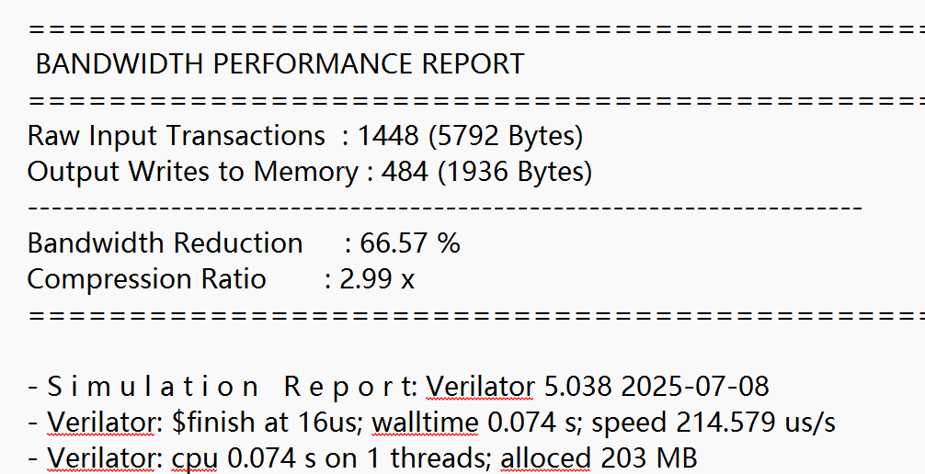
Simulation: Performance Metrics and Success Criteria
Key Indicators
High Ratio: Expected during Phase 1 (heavy accumulation).
Low Ratio (1.0x): Expected during Phase 2 (all outliers bypass).
FIFO Integrity: dram_valid should stay high during burst periods without losing data.
Compression Ratio
Bandwidth Reduction
The ratio of raw input transactions to compressed memory writes.
Calculated as 1−(Output Tx/Input Tx).
Notes:
"At the end of the simulation, the performance monitor generates a report. We look at the Bandwidth Reduction percentage and the Compression Ratio. For example, in Phase 1, we expect a very high compression ratio because many inputs are merged into a single output. This report confirms if our design effectively reduces the traffic sent to the DRAM."

Slide 22
Simulation Results
Final Writeback Statistics:
Direct Trigger (|grad| ≥ THRESHOLD): 19 events
Accumulation Threshold (accum ≥ THRESHOLD): 6 events
MAX_UPDATES Force Flush: 0 events
Eviction (tag conflict): 6 events
DRAM Writes (FIFO → DRAM): 31 events
Total L1 → FIFO pushes: 31
Total FIFO → DRAM writes: 31
The perfect match between FIFO pushes and DRAM writes confirms full data integrity.

Slide 23
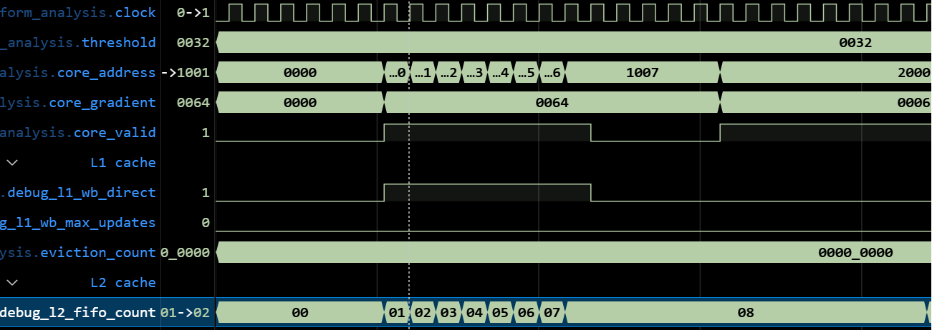
Testbench: Direct Trigger Path
Nineteen large gradients (≥ threshold) correctly bypassed the L1 accumulator and were directly pushed into the L2 FIFO.
Verified behaviors:
No L1 allocation
Immediate FIFO push
Proper debug signal activation
You can see from here when the fifo2 which is the second stage is always increases due to 64 (hex)
Is bigger than the threshold and keep its stages and stops when the core_valid pulls down to zero.
Which means the fifo2 is always been written data directly from the Streamer.

Slide 24
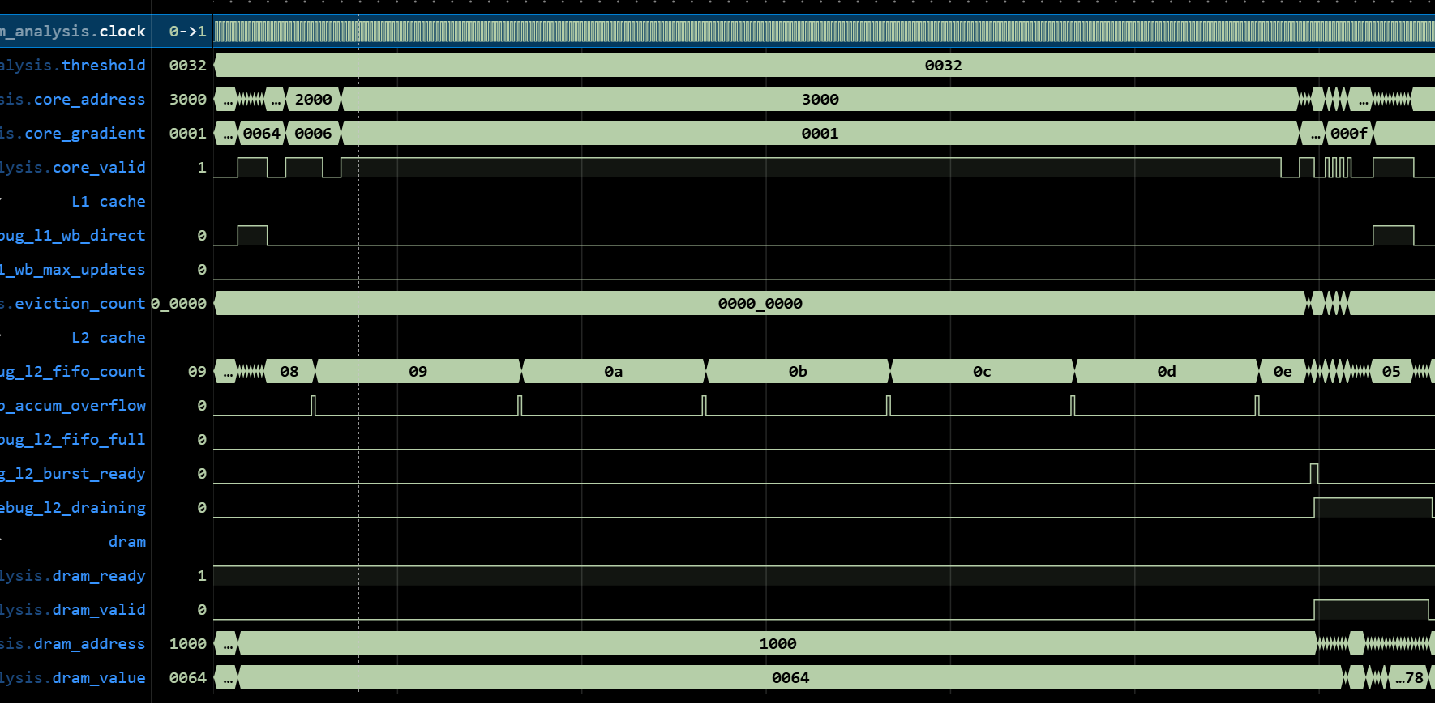
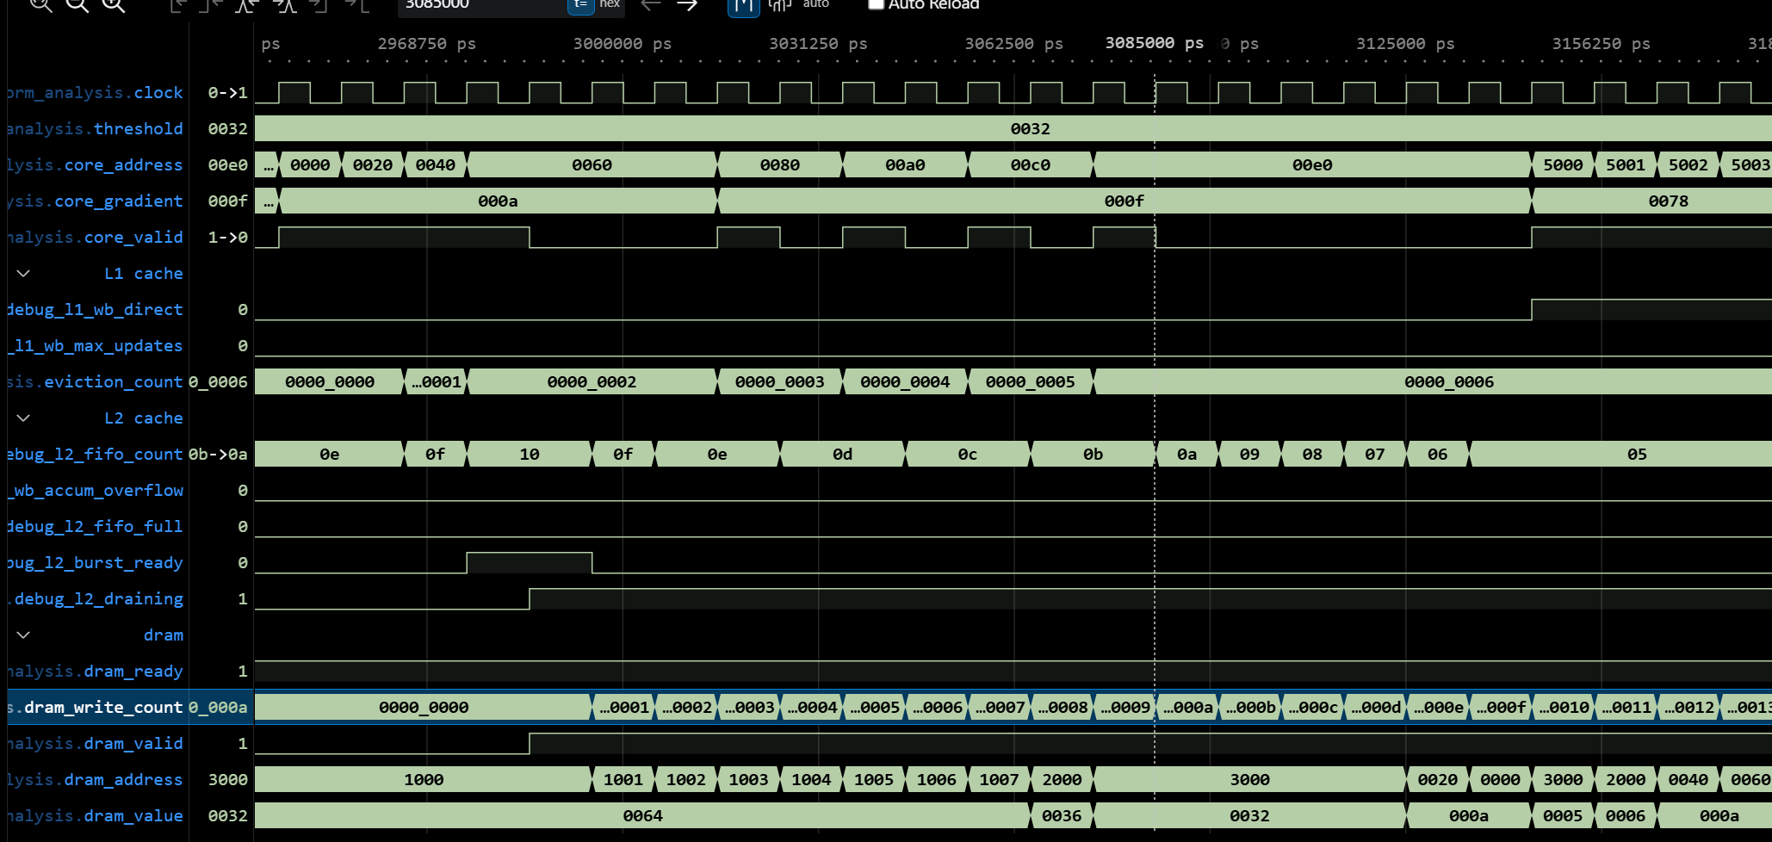
Testbench: FIFO Burst Writeback
The FIFO triggered burst writeback once the occupancy reached 16 entries.
Verified behavior:
FIFO count decreased from 16 to 0
Continuous DRAM write for 31 cycles
Proper draining state control
No data loss
You can see from here when the L2 cache draining is happen which means the L2 is writing its data to dram . So obviously , the dram_count is increasing and the fifo count is decreasing at the same time which corresponding to my thinking. The burst_ready signal is where the signal processing start.

Slide 25
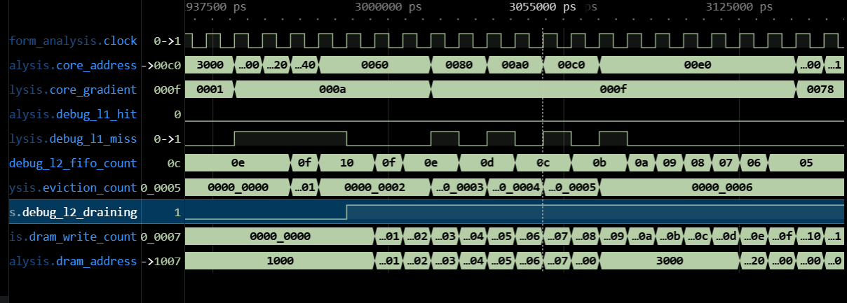
Testbench: Eviction Mechanism
Six tag-conflict eviction events were successfully detected and processed.
Each eviction correctly pushed the victim entry into the L2 FIFO.
This is the eviction , when the core address change from 2000-3000-0000-0020-0040-0060-0080,it occurs during the 0040, because the set_full signal which directly assigned to the eviction_count. So, after the 0040 the evicted data flow to the fifo , you can see the fifo count increases from 0f to 10 and then it stops because the fifo is full and is about to output the data to the dram.

Slide 26
Simulation Conclusion
Key Achievements:
Eviction mechanism fully operational
Correct writeback hierarchy behavior
Proper priority handling between flush mechanisms
Complete debug visibility across L1/L2/L3
The simulation completed successfully and all critical mechanisms were verified. The system now functions as intended, with verified correctness across all writeback paths.

Slide 27
04-5
Some Sub-Designs

Slide 28
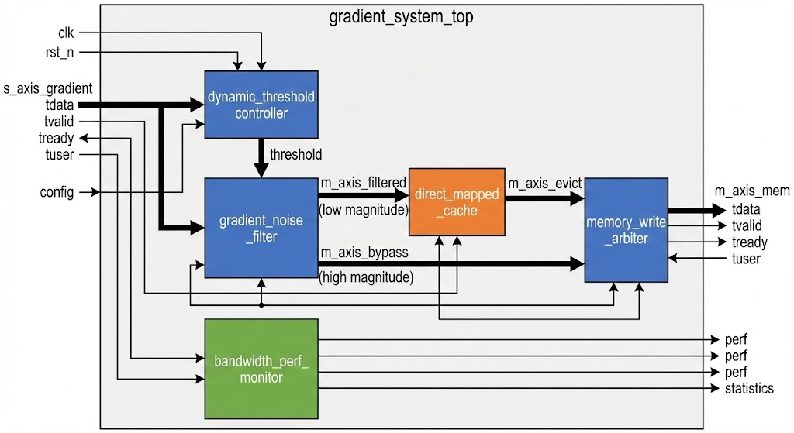
Ⅰ. Dynamic Adaptive Gradient Compressor
Core Module
The system employs a modular and pipelined design, where data flows through four core modules
Dynamic Threshold Controller
This module computes a dynamic threshold using the Exponential Moving Average (EMA) of incoming gradient magnitudes.
Gradient Noise Filter
Direct-Mapped Cache
Memory Write Arbiter

Slide 29
Simulation Testbench
Pure Accumulation
Target: Verify Cache RMW (Read-Modify-Write).
Action: Multiple small-magnitude updates.
Goal: Ensure correct accumulation, no data loss.
Mixed Testing
Target: Write-back trigger logic.
Action: Minor fluctuations → Threshold breakthrough.
Goal: Validate memory write upon reaching critical point.
High-Magnitude Bypass
Target: Threshold Decision Logic.
Action: Large gradients bypass cache.
Goal: Immediate update of critical gradients.
Cache Conflicts
Target: EMA adaptive threshold stability.
Action: Massive random positive/negative gradients.
Goal: Simulate real-world ML gradient distributions.
Dynamic Convergence
Target: Direct-Mapped Cache vulnerabilities.
Action: Rotate Tag, lock Index (Force Miss & Evict).
Goal: Observe conflict resolution, prevent data corruption.

Slide 30
Simulation Results
Exceptional Bandwidth Optimization:
The final Performance Report is the standout highlight. The system successfully compressed 1,276 raw input transactions (5,104 Bytes) down to a mere 614 output writes (2,456 Bytes).
Core Metrics:
It achieved a 51.88% bandwidth savings and a 2.08x compression ratio. This means your accelerator successfully slashed memory/bus write traffic by more than half, which is an outstanding achievement for a gradient processing system.

Slide 31
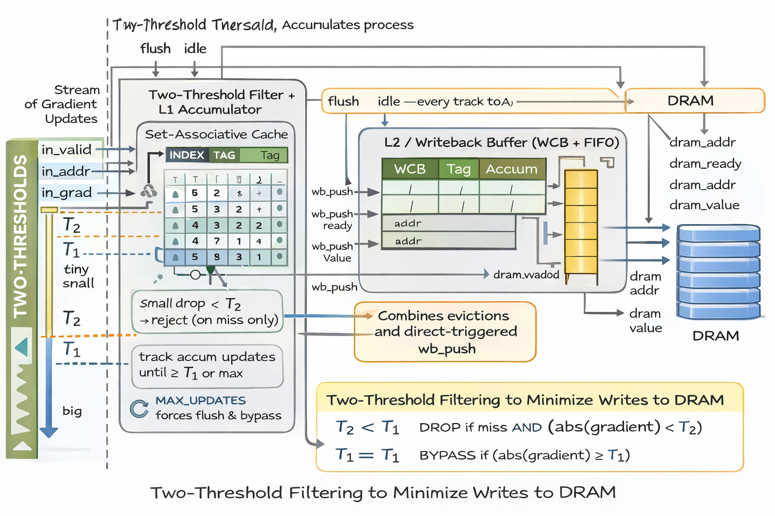
Ⅱ. Dual Threshold Gradient Compressor
Core Module
This design a second (smaller) threshold before updates enter the L1 accumulator, so tiny gradients are dropped early, reducing L1 pollution / eviction
L1 accumulation buffer (set-associative)
L2 writeback buffer (WCB + FIFO)
Two-threshold policy
T1 = THRESHOLD: big gradients bypass L1 and go directly to L2.
T2 = SMALL_THRESHOLD (smaller): drop tiny gradients on MISS only to prevent L1 pollution/evictions.
Flush barrier semantics

Slide 32
Simulation Testbench
Tiny-Miss Drop Storm
Proves (your new feature): the second threshold filter works as intended: tiny gradients on MISS are dropped, preventing L1 pollution/eviction pressure.
Max-Updates Hammer
Proves: “no small-gradient gets stuck forever” — your MAX_UPDATES forward-progress guarantee is functional.
Conflict Eviction stormBypass
Proves: eviction path is correct and lossless (victim pushes occur, no corruption), including set-conflict worst case.
Training-Like Steps
Proves: flush/idle barrier semantics are correct across repeated step boundaries (LLM training behavior).
Direct-Trigger Flood
Proves: large gradients don’t touch L1 and are safely buffered through L2 under heavy backpressure—no packet drop, stable handshakes.

Slide 33
Simulation Result
Exceptional Bandwidth Optimization:
The final Performance Report is the standout highlight. The system successfully compressed 1,206 raw input transactions (4824 Bytes) down to a mere 549 output writes (2196 Bytes).
Core Metrics:
It achieved a 54.48% bandwidth savings and a 2.20x compression ratio. This means your accelerator successfully slashed memory/bus write traffic by more than half, which is an outstanding achievement for a gradient processing system.

Slide 34
05
Challenges & Lessons Learned

Slide 35

Challenges & Lessons Learned: Prompts Engineering
Target-Output Mismatch
Use structured, terminological prompts to avoid semantic confusion and model misunderstandings
Testbench Functionality
In addition to the testbench generated by the platform, add additional testbench to pass specific and stressed tests
Structure Granularity
When meticulous revision is needed, use more fine-grained prompt descriptions, such as unit level and variable name level to identify the modification

Slide 36
Challenges & Lessons Learned: Architecture Design
Pipeline Design
If the streamer and the accumulator could be pipelined, there will be more hazards and forward mechanism to be used. There is a trade-off, more speed or less complexity.
Single Cycle
Using single cycle might be bad for CPI but it would be better for the accuracy and might be good for LLM training because most accelerator doesn't require all algorithm. Guarantee accuracy is much more important than increasing such slightly changing speed.
Cache Transmission
Try to use the wright back and set associative memory instead of direct map and write through because the latter one might cause more address tag miss.

Slide 37
06
Future Work

Slide 38

Future Work
Future work will focus on validating the Gradient Compressor and Accumulator beyond synthetic traffic patterns and manual testbenches, and more fine-grained architecture optimization.
Simulation with Real Gradient Traces
3-stage pipelined structure for the threshold calculation
01
04
Architectural Compatibility and integration
Fune-tuned threshold for FPGA and tape out
02
05
Meticulous revision for clock cycle corresponding to the logic functionality
End-to-End Performance
03
06

Slide 39
TRAIN NEO BIT
THANK U
FOR WATCHING
By Feiyu Jia, Heng Pu, Lixuan Xu, Yuhan Jiang
https://github.com/fjia-xu/Cognichip-Hackathon-by-Train-Neo-Bit.git

Slide 40

Reference
[1] A. Gholami, Z. Yao, S. Kim, C. Hooper, M. W. Mahoney, and K. Keutzer, "AI and Memory Wall," IEEE Micro, vol. 44, no. 3, pp. 33-39, May-June 2024.
[2] B. R. Bartoldson, B. Kailkhura, and D. Blalock, "Compute-Efficient Deep Learning: Algorithmic Trends and Opportunities," Journal of Machine Learning Research, vol. 24, no. 122, pp. 1-77, 2023.
[3] A. Rebai and M. Canini, "OptimusNIC: Offloading Optimizer State to SmartNICs for Efficient Large-Scale AI Training," in Proceedings of the 5th Workshop on Machine Learning and Systems (EuroMLSys '25), 2025, pp. 176–182, doi: 10.1145/3721146.3721960.
[4] Y. Lin, S. Han, H. Mao, Y. Wang, and W. J. Dally, "Deep Gradient Compression: Reducing the Communication Bandwidth for Distributed Training," in Proceedings of the International Conference on Learning Representations (ICLR), 2018. (Note: This covers both the 4th and 7th lines in your prompt, as they are the exact same paper).
[5] D. Alistarh, T. Hoefler, M. Johansson, S. Khirirat, N. Konstantinov, and C. Renggli, "The Convergence of Sparsified Gradient Methods," in Advances in Neural Information Processing Systems (NeurIPS), vol. 31, 2018.
[6] I.-H. Li and T.-S. Chang, "Dynamic Gradient Sparse Update for Edge Training," arXiv:2503.17959, Mar. 2025. https://arxiv.org/abs/2503.17959.

